Slide 1
Cyber security

Slide 2
About me
Name: Slav Astinov Age: 33 Born in Razlog, Bulgaria

Slide 3
Experience

Slide 4
Gallery

Slide 5
Gallery

Slide 6
Gallery

Slide 7
Our school

Slide 8
What Exactly is Cybersecurity?
To improve your ability to keep yourself and your loved ones cybersecure, you need to understand what cybersecure means,what your goals should be vis-à-vis cybersecurity, and what exactly you’re securing against. As you can see in these slides, these answers can vary dramatically between people, company divisions, organizations, and even within the same entity at different times.

Slide 9
Cybersecurity Means Different Things to Different Folks
While cybersecurity may sound like a simple enough term to define, in actuality, from a practical standpoint, it means quite different things to different people in different situations, leading to extremely varied relevant policies, procedures, and practices.
An individual who wants to protect her social media accounts from hacker takeovers, for example, is exceedingly unlikely to assume many of the approaches and technologies used by Pentagon workers to secure classified networks.

Slide 10
for example:
For individuals, cybersecurity means that their personal data is not accessible to anyone other than themselves and others whom they have so authorized, and that their computing devices work properly and are free from malware. For small business owners, cybersecurity may include ensuring that credit card data is properly protected and that standards for data security are properly implemented at point-of-sale registers. For firms conducting online business, cybersecurity may include protecting servers that untrusted outsiders regularly interact with.

Slide 11
What is at risk?
Personal risks: Many people store private information on their electronic devices, from explicit photos to records of participation in activities that may not be deemed respectable by members of their respective social circles. Such data can sometimes cause significant harm to personal relationships if it leaks. Likewise, stolen personal data can help criminals steal people’s identities, which can result in all sorts of personal problems.

Slide 12
Getting to Know Common Cyberattacks
In this chapter, you find out about the different types of problems that cyberattackers can create through the use of attacks that commonly impact individuals and small businesses.

Slide 13
Phishing

Slide 14
Example
For example, a criminal may send an email that appears to have been sent by a major bank and that asks the recipient to click on a link in order to reset his or her password due to a possible data breach. When the user clicks the link, he or she is directed to a website that appears to belong to the bank, but is actually a replica run by the criminal. As such, the criminal uses the fraudulent website to collect usernames and passwords to the banking site.

Slide 15
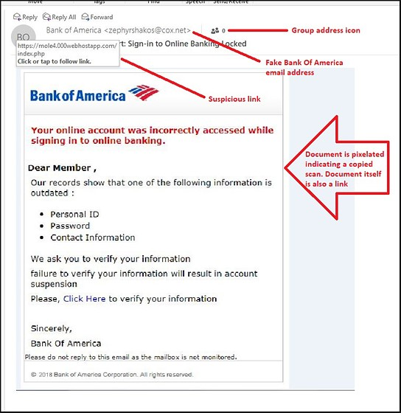

Slide 16
CEO Fraud

Slide 17
Personal data theft
*Criminals often try to steal people’s data in the hope of finding items that they can monetize, including: *Data that can be used for identity theft or sold to identity thieves *Compromising photos or health-related data that may be sellable or used as part of blackmail schemes Information that is stolen and then erased from the user’s machine that can be ransomed to the user *Password lists that can be used for breaching other systems *Confidential information about work-related matters that may be used to make illegal stock trades based on insider information Information about upcoming travel plans that may be used to plan robberies of the victim’s home

Slide 18
Malware
Malware, or malicious software, is an all-encompassing term for software that intentionally inflicts damage on its users who typically have no idea that they are running it. Malware includes computer viruses, worms, Trojans, ransomware, scareware, spyware, cryptocurrency miners, adware, and other programs intended to exploit computer resources for nefarious purposes.

Slide 20
Viruses
Like biological viruses, computer viruses can’t spread without having hosts to infect. Some computer viruses significantly impact the performance of their hosts, while others are, at least at times, hardly noticeable. While computer viruses still inflict tremendous damage worldwide, the majority of serious malware threats today arrive in the form of worms and Trojans.

Slide 21
Ransomware
Ransomware is malware that demands that a ransom be paid to some criminal in exchange for the infected party not suffering some harm. Ransomware often encrypts user files and threatens to delete the encryption key if a ransom isn’t paid within some relatively short period of time, but other forms of ransomware involve a criminal actually stealing user data and threatening to publish it online if a ransom is not paid.

Slide 24
Prevention on mobile devices

Slide 25
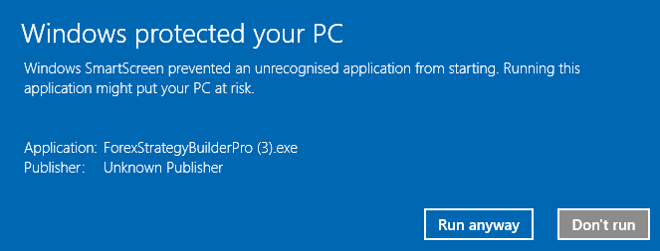
Prevention on a pc

Slide 26
Improving Your Own Personal Security
*Understand why you may be less cybersecure than you think. *Find out how to protect against various cyberdangers. *Learn about physical security as it relates to cybersecurity.

Slide 27
Your home computer(s)
Your home computers may suffer from one or major types of potential problems relevant to cybersecurity
Lets check some awesome Cybersecurity facts

Slide 32
Thank you for your attention!

