Slide 1
“Truth and Lying in Politics: Reflections on The Pentagon Papers.” Hannah Arendt
mag. Sofija Baškarad

Slide 2
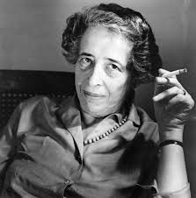
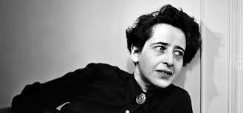
Hannah Arendt (1906-1975)
Hannah Arendt (1906-1975) was a German-born Jewish American political theorist and is best known for her writings on totalitarianism.
Hannah Arendt led an extraordinary life. She endured Nazi persecution firsthand, survived harrowing escapes from country to country in Europe. Before, she had studied with Martin Heidegger and Karl Jasper, later she befriended such luminaries as Walter Benjamin and Mary McCarthy, in a world inhabited by Marc Chagall and Marlene Dietrich, Albert Einstein and Sigmund Freud.

Slide 3
Recognition for her thinking came in the shape of awards, fellowships, book contracts, and academic achievements, including becoming the first woman full professor at Princeton University.

Slide 4
political theorist
The brilliant thinker, who received her doctorate from Karl Jaspers at the age of 22, did not see herself as a great philosopher. Right at the beginning of the famous TV interview in 1964 she replied to her host Günter Gaus: “I have to contradict you. I don't see myself as a philosopher, but as a political theorist. "

Slide 5
„Quote “
Lügen erscheinen dem Verstand häufig viel einleuchtender und anziehender als die Wahrheit, weil der Lügner den großen Vorteil hat, im voraus zu wissen, was das Publikum zu hören wünscht. (Die Lüge in der Politik, 1972, S.10)
Lies are often much more plausible, more appealing to reason, than reality, since the liar has the great advantage of knowing beforehand what the audience wishes or expects to hear.
Laži se zdijo razumu pogosto bolj jasne in privlačnejše kakor resničnost, saj ima lažnik veliko prednost, ker že v naprej ve, kaj bi občinstvo rado slišalo.

Slide 6
Mentimeter
What is the central message of this quote?
Formulate the statement in your own words (one sentence).
2. What areas of life does the quote relate to?
3. Note three things that come to mind when you hear this quote.
4. Place the quote in the historical context: Before which historical
background did Hannah Arendt write this sentence?

Slide 7
factual truth
whenever Arendt talks about truth it's always modified so she going to talk about philosophical truth, rational truth, mathematical truth, scientific truth but the kind of truth that she's talking about in this essay and that she returns to time and again is factual truth
what do we do when someone attacks our perceptions of the world of reality as we see it.

Slide 8
PART 1
brief history of the relationship between truth and politics in the Western tradition
beginning with Plato, Hobbes, Kant
that truth and politics have never been on good terms with one another, and that the lie has always been a justified tool in political dealings
why is it that in the political realm we value lie but not truth
truth is powerless in the public realm
distinction between what she calls truth tellers and politics
factual truth is incredibly fragile

Slide 9
1. PART
Who is the truth teller who tells factual truth?
examples
1. Socrates who of course was sentenced to death for telling the truth
2. Homer (who is telling the both sides of Trojan war
truth teller is not politician who stands inside the public realm and engages in politics
the truth teller is someone who stands alone outside the realm of human affairs

Slide 10
PART 1 - FACTUAL TRUTH
factual truth so the facts and events of our existence our life are the outcome of us living together
so when power or politics starts to attack or chip away at these factual truths
the lies are destroying the world that we share
are much more fragile than other forms of mathematical theories or scientific discoveries because they exist in the ever-changing of human affairs

Slide 11
PART 2
Arendt is going to primarily turn to Plato to talk about the historical relationship between truth and opinions and the difference between truth and opinions
dichotomy
how we engage with one another: DIALOG - RET
truth | opnien
life of the philosopher | life of the citizen
dialog | rhetoric

Slide 12
What it means not just to be a truth teller?
What it means not just to be a truth teller today which is always a dangerous profession to stand outside the realm of politics but to enter into the public sphere and to express one's political opinion is has in itself become a very dangerous business where we are met with increasing hostility and less dialogue.
enter into the marketplace = Agora = where we don't just exchange things but so ideas
philosophical truth is made public it becomes opinion
factual truth it‘s by witnesses

Slide 13
PART 3 - intellectual thinking exercise
how we form political opinions and how our political opinions take on firmness and validity
we form opinions on a political issue by coming into conversation with viewpoints that are not our own and by incorporating them into our own thought process.
importance of thinking to the relationship between truth and politics
It's better to be at odds with the whole world than to be at odds with ourselves.
Bolje je trpeti krivico, kakor jo povzočati.
Ne nasprotuj si!

Slide 14
PART 4 Opposite of factual truth in modernity is the lie
deliberate falsehood or a lie
character of the liar
a) the liar is already in the realm of politics
b) he's an actor by nature
c) he wants to make the world otherwise
d) he wants to make the world different
e) he wants to change the world
f) he's challenging the factual truth of the world
truth-telling now has never been a political virtue because truth-telling doesn't desire to make the world other than it is
truth-telling is a way of telling it like it is
political lies are very dangerous these deliberate political lies that consistently attack factual truth
that organized lying has always destroyed whatever it has decided to negate: characteristic totalitarian governments

Slide 15
Part 4 LIE IS APPEALING
A lie is appealing
Traditional lie was understood to be a political virtue = substitute for a form of violence
was never meant to deceive everybody
it was directed at an enemy it was a tool used in deception but
modern lies are kind of image making representations
meant to deceive everybody
subsitution of lies for factual truth
reality = fiction
lies are being used consistently to remake the world

Slide 16
Part 5 Why do we need truth?
even though truth is powerless and always defeated when it comes into a head-on clash with power
power can destroy truth but it can never actually replace truth
LIE IS APPEALING BUT IT CAN NOT REPLACE TRUTH.
truth teller as somebody who stands outside
is not only dangerous
of being alone
we may call truth: the ground on which we stand in the sky that stretches above us interesting to note that both are allwas moving

Slide 17
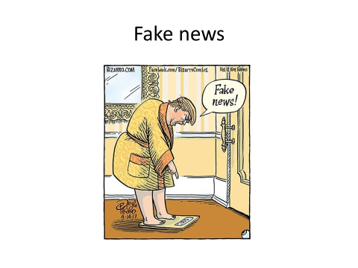

Slide 18
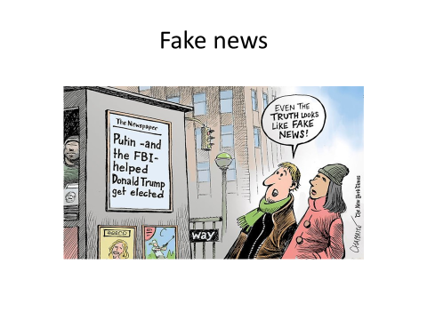

Slide 19
DEBATE
The lie has always been instrumental to gaining political advantage and favor.
Why now then, all of sudden, do we decry the emergence of fake news? Why are fact-checkers and fact-checking streams such a common feature of political debates? Why do we care about truth so much in this particular moment?

