Slide 1
INTRO
Erasmus+ Fake News project, Slovenia, 2021
Marko Majce

Slide 2
Few Word by our headmaster

Slide 4
Labeling // Forming groups
Everybody uses first name and country code (AT, BG, DE, FR, SE, SI):
Example: Marko, SI
How will you do it:
- Go to participants – on the top of the list, there is you
- click on your name, then go to MORE, and choose RENAME and rename yourself
Please enrol in different international groups (WHITE, YELLOW, GREEN, RED, BLUE):
https://docs.google.com/spreadsheets/d/1nrOX2PQVq5FS7MjP5NRq1WhBIfBX7LWeE1HLN2qKzcY/edit?usp=sharing

Slide 5
Populism & fake news
Erasmus+ Fake News project, Slovenia, 2021
Marko Majce

Slide 6
What is populism
Notion first positive (USA in the second half of the 19th century) – against moneyed elites of the East
McCarthy – populism on the right wing (1950s) – attacking intellectual elites
Wallace – attacking Vietnam War opposers, media, liberals
Bernie Sanders – socialistic ideas
Donald Trump – attacking elites and liberals
See: https://www.youtube.com/watch?v=_uA1GBzXzr4

Slide 7
What is populism
Explainity: https://www.youtube.com/watch?v=jRZURSFV9hk
»When it comes to complicated issues, populist usually provide simple solutions.«

Slide 8
What is populism
Yascha Mounk, John Hopkins University: https://www.youtube.com/watch?v=RUNzEhKphno
Anti-elitist element
Anti-pluralist element
Two fundamental values: Liberal democracy = democratic republic (collective self-determination) + liberalism (individual freedoms)
Illiberal democracy --> illiberal dictatorship
14.000 GDP per capita, at least two turns of democratic government

Slide 9
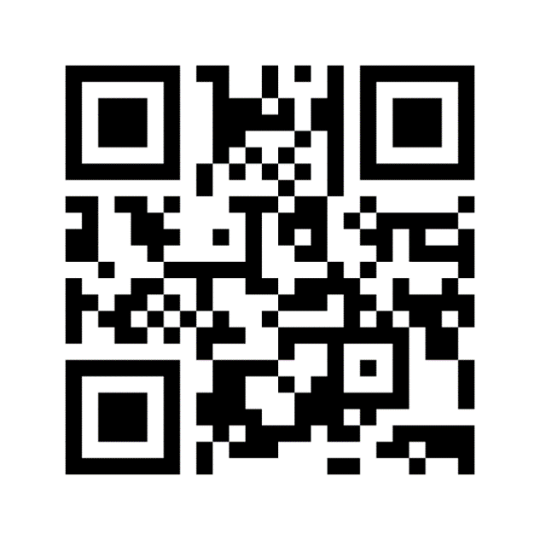
What is populism
Mentimeter 1: Name a party or a politician from your country, which you see as a populist.
https://www.menti.com/bxty5mn261
8524 9680

Slide 10
What is populism
Mentimeter 2: Do you think, there is more populism in your country now than a year ago?
https://www.menti.com/bxty5mn261
8524 9680

Slide 11
What is fake news
“Fake news is a false or misleading information presented as news.”
“Bed news sells.”
The aim of fake news is to attract attention, often for political or economic reasons.
Fake news are considered to be a means in election campaigns.
Slovenian examples of fake news: Bitcoin city. (Scam)
The phenomenon not new, but social media favoured the spreading of fake news.
No journalistic professionalism in social media!
Detecting fake news – algorithms to uncover it

Slide 12
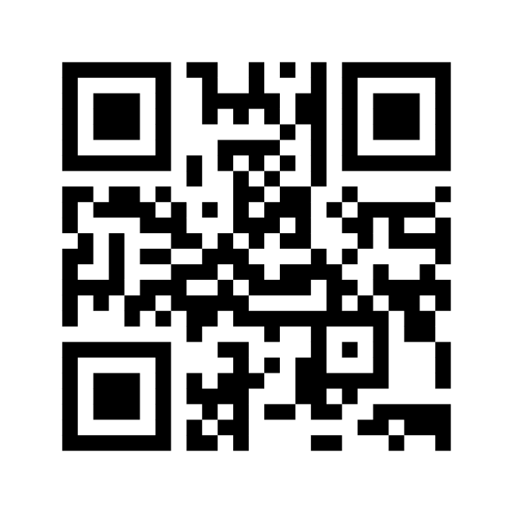
What is fake news
Mentimeter 3: Have you ever been deceived by a fake news?
https://www.menti.com/2uof2nz2hz
The voting code 4922 5234 is valid now and expires in 2 days.

Slide 13
What is fake news
Mentimeter 4: Do you know, how to uncover fake news?
https://www.menti.com/2uof2nz2hz
The voting code 4922 5234 is valid now and expires in 2 days.

Slide 14
How are populism and fake news related
Populism is considered to have a more black-white worldview – simple solutions for complex problems.
Fake news is a news which is usually very striking and supports non-elitist, non-liberal thinking.
It usually addresses our views that are more underlying, biased and serves us as a confirmation of our presentiment. (“I knew it!”)
Populist politicians are acting as a sole speaker of one social group – therefore they usually don’t choose means to represent themselves as such.

Slide 15
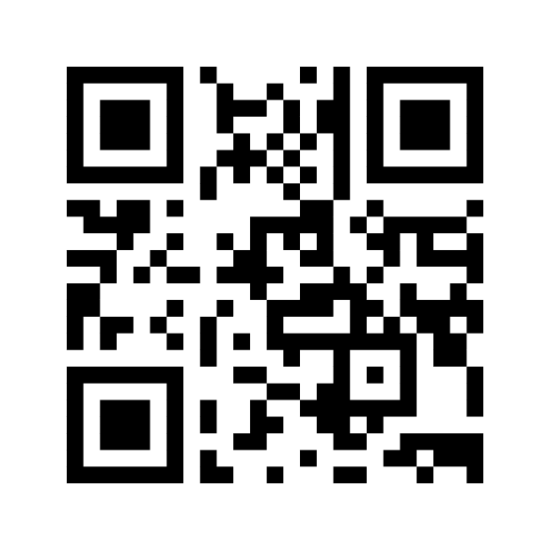
How are populism and fake news related
Mentimeter 5: Are politicians in your country using fake news?
The voting code 7957 9469 is valid now and expires in 2 days.
https://www.menti.com/uo9he56zzp

Slide 16
Why should we avoid populism?
Politician sets himself as a spokesperson for particular group of people – antidemocratic
Idea of toleration – accepting the realities of the others
Notions of self-restrain
The worldview of a populist – I have right to anything needed to impose things because I’m right.
To eliminate a populist, moderate politicians become populistic … death spiral, everybody is pushing to the maximum → democracy very fragile.

Slide 17
Why should we avoid populism?
Mentimeter 6: Do you think democracy is the best way of running a state?
The voting code 7957 9469 is valid now and expires in 2 days.
https://www.menti.com/uo9he56zzp

Slide 18
Quiz – solving it together – in international teams
https://forms.gle/GqthGYZytuBB3Lzy5

Slide 19
Drafting a summary together – in international teams
Go to your teams and discuss a short summary. Go to the common document and write some keywords/short summary of the lesson.
Breakout rooms are labelled with colours and have their specific documents:
White group - https://docs.google.com/document/d/11J-yMvIPl8HstN-x0HvTmvsdPOCri-GalGgn6vMve0Y/edit?usp=sharing
Yellow group - https://docs.google.com/document/d/13ZgMne73smMMNcX3fXbuzDXdH4_a6cX_joa1jh3Vm7k/edit?usp=sharing
Green group - https://docs.google.com/document/d/1NZyEPWq4CzhaeMu3DaBbyOJSvq76XyvbTGB6LdxluCQ/edit?usp=sharing
Blue group - https://docs.google.com/document/d/1O9_vqW_86NzI7PBnhL1iBmCGl62sLFy9ImjKcPSsR14/edit?usp=sharing
Red group - https://docs.google.com/document/d/1PtF1yaOeEcMQZe6H04teXu2-daX_hj1f-ODF0vHtpgk/edit?usp=sharing

Slide 20
Answering some questions and presenting them to the other groups – in international teams
WHITE: In which situation do you think populism makes sense?
RED: Are there countries in Europe, where there is less populism as elsewhere? Why?
BLUE: Why are situations like covid pandemics threats to democracy?
YELLOW: How can citizens prevent polarization in the society?
GREEN: How a society can fight misinformation?
Breakout rooms are labelled with colours and have their specific documents:
White group - https://docs.google.com/document/d/11J-yMvIPl8HstN-x0HvTmvsdPOCri-GalGgn6vMve0Y/edit?usp=sharing
Yellow group - https://docs.google.com/document/d/13ZgMne73smMMNcX3fXbuzDXdH4_a6cX_joa1jh3Vm7k/edit?usp=sharing
Green group - https://docs.google.com/document/d/1NZyEPWq4CzhaeMu3DaBbyOJSvq76XyvbTGB6LdxluCQ/edit?usp=sharing
Blue group - https://docs.google.com/document/d/1O9_vqW_86NzI7PBnhL1iBmCGl62sLFy9ImjKcPSsR14/edit?usp=sharing
Red group - https://docs.google.com/document/d/1PtF1yaOeEcMQZe6H04teXu2-daX_hj1f-ODF0vHtpgk/edit?usp=sharing

Slide 21
Preparation for the next presenter
1. Is this video real?
https://www.youtube.com/watch?v=6y2I0xAPSQk
2. Is this news true?
A robot lizard has been built that can climb up walls just like the real thing. A team at the University of the Sunshine Coast, Australia, created the robot to study lizards' movements and what makes them so efficient. They found that, for lizards and robots alike, a "Goldilocks" approach of going not too fast and not too slow is best.
3. How did you find out?

Slide 22
Preparation for the next presenter
More videos:
https://www.youtube.com/playlist?list=PLNhGUTG3M27Z5tYPUeGI0R29txjwafoEY

