Slide 2
Sights

Slide 3
Withabout 31,000 inhabitants and covering 7,972 hectares of land,the new
_,_m unicipality was established at the end of 1994.

Slide 4
DOMŽALE
Domžale Municipality is one of over 200 municipalities in Slovenia. Here are the three golden ears of corn,which are interconnected in straw braids. It is the symbol which is presented in the coat of arms of Domzale.

Slide 5
Domžale is a city and administrative centre of Municipality of Domžale in Slovenia.
The municipality lies near the foothills of the Kamnik Alps and is crossed by the
Kamnik Bistrica River,which originates in these mountains.

Slide 6
Krumperk Castle is a castle or manor located in Gorjuša near the town of Domžale in central Slovenia. According to Valva sor, the castle was built in the late 13th century by the noble Rabensbergs from Koprivnik.

Slide 7
V'olčjiPotok is best known forits arboretum,the largest and most popular botanical garden in Slovenia. The Volčji Potok Arboretum is open from the beginning of March until the end of November.

Slide 8
Kamniška Bistrica is the river in Domžale. It is an Alpine river in northern Slovenia, a left tributary of the Sava River.

Slide 9
This is the stadium of Domžale, whereDomžale football club plays and trains. In addition, the municipality of Domžale organizes various sports events and has got many sports places such as tenis courts and a hall, a swimming pool, football fields with a race track and basketball courts.

Slide 10
Menačnik‘s house is located in a typical rural Domžale.It was built in 1898 on the ruins of an earlier wooden building.

Slide 11
Česmin park
There are a lots of recreation and green areas in our municipa lity.
There are ma ny cultural and sport events that are organized for our
in habita nts.

Slide 12
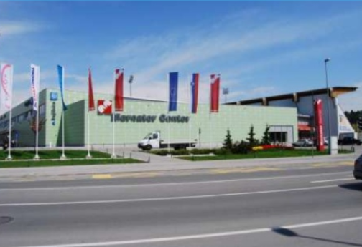
Mercator is the most popular
shoppingcentre in Domzale.There's also a library in the building.

Slide 13
Different names and forms of the Secondary School Domžale

Slide 14
Pupils and teachers in front of a pedestrian bridge over Kamniška Bistrica

Slide 15
Dance hall – upper gym

Slide 16
Fitness cornes in the dance hall

Slide 17
Chess competition

Slide 18
The new gym

Slide 19
In the municipality centre

Slide 20
The near football field

Slide 22
Rugby players on a sports day

Slide 23
How a LEGO robot works

Slide 24
Quizzes

Slide 25
The mayor

Slide 26
Presenting a project

Slide 27
Erasmus+ project in France 2019

Slide 28
Erasmus+ project in France 2019

Slide 29
In the Slovenian parliament

Slide 30
In the 1970s in front of the old school

