Slide 1
Mitja SARDOČ, PhD
CITIZENSHIP EDUCATION IN A PLURALLY DIVERSE POLITY

Slide 2
CITIZENSHIP EDUCATION IN A PLURALLY DIVERSE POLITY
The phenomenon of ‘traveling concepts’
The ‘moral compass’
Citizenship education: ‘traditional’ problems and challenges
Citizenship education: ‘contemporary’ problems and challenges
Citizenship education: ‘non-standard’ problems and challenges
Citizenship education in the 21st century
‘Back to the future’
Freedom of expression: pro et contra

Slide 3
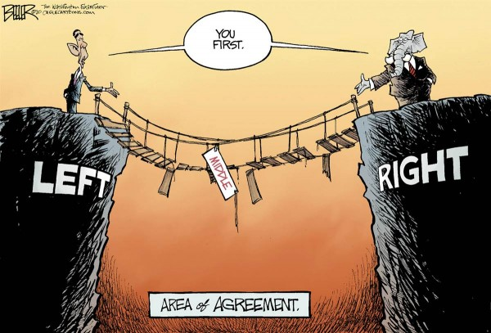
‘TRAVELING CONCEPTS’
There has been an interesting phenomenon where concepts traditionally positioned on one side of the political spectrum (either ‘left’ or ‘right’) become part of the vocabulary of the opposite side. For example, freedom of expression, patriotism, responsibility, choice, zero tolerance, integrity, virtue etc.

Slide 4
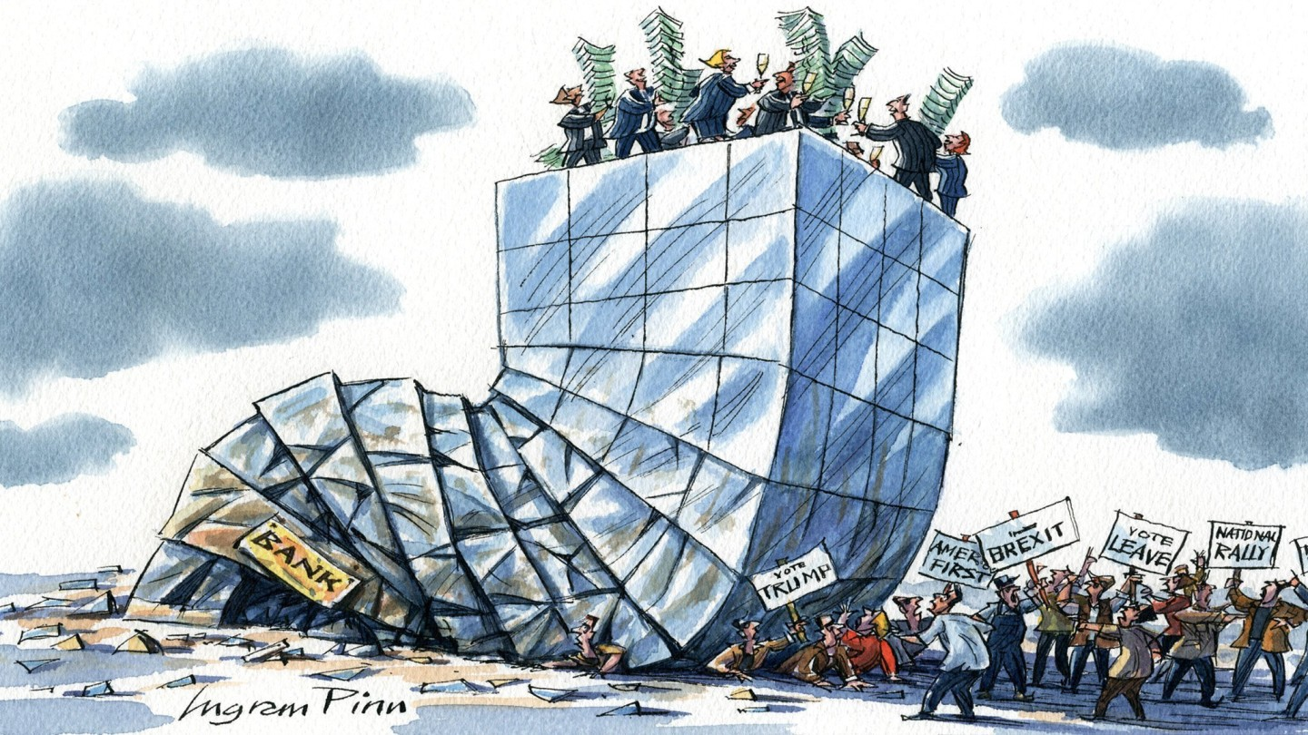
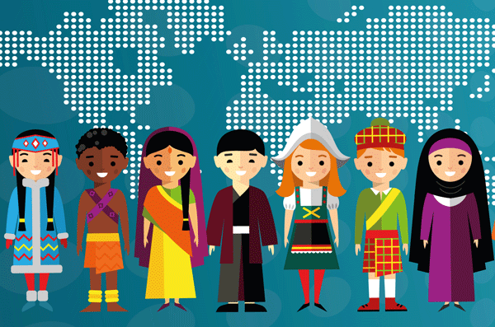
‘THE MORAL COMPASS’
GLOBAL FINANCIAL CRISIS
CULTURAL DIVERSITY
neoliberalism versus egalitarianism
liberalism versus multiculturalism
versus feminism etc.
Answers provided by these ‘-isms’ too often become part of the problem and not the solution (e.g. the ‘doctrine of double effect’ (unexpected negative side effects)).
In particular, citizenship education and education in general has been the ‘battleground’ where these (and other) issues have been fought over.

Slide 5
CITIZENSHIP EDUCATION: ‘TRADITIONAL’ PROBLEMS AND CHALLENGES
For several decades now, citizenship education has been replete (at both the theoretical and the practical level) with some foundational questions there has been no consensus about, e.g.
Are equal rights a sufficient condition of civic equality?
Is patriotism a legitimate form of expressing one’s allegiance to a political community?
When, how and WHY should diversity be included in everyday school practice?
Is toleration the most viable answer to the problems and challenges raised by ‘deep diversity’?
Should we include topics in educational practice that raise pressing ‘moral dilemmas’ (controversial issues)?
Is freedom of expression absolute and what limits – if any – should apply?
Is ‘digital citizenship’ part of the solution or just another problem to be tackled?

Slide 6
CITIZENSHIP EDUCATION: ‘CONTEMPORARY’ PROBLEMS AND CHALLENGES
Contemporary societies face a number of challenges that threaten their very principled bases including security, democracy, liberty and toleration. The most pressing ‘challenges’ (both ‘traditional’ as well as ‘contemporary’) include:
socio-economic problems (poverty & social exclusion)
‘non-liberal democracies (phenomenon of the ‘shrinking civic space’)
radicalization, violent extremism & terrorism
lack of trust in the democratic processes and institutions
hate speech and xenophobia
populism
fake news

Slide 7
CITIZENSHIP EDUCATION: ‘NON-STANDARD’ PROBLEMS AND CHALLENGES
Furthermore, citizenship education also faces also important conceptual and policy challenges associated with a set of ‘non-standard’ phenomena (together with various other problems), for example
What is ‘moral panic’?
Is ‘zero tolerance’ a solution to every problem being encountered?
How to make sense of the widening ‘opportunity gap’ (despite the existence of equality of opportunity)?
How to tackle the phenomenon of the ‘shrinking civic space’?
Is ‘political correctness’ part of the solution or yet another problem?
How populism is to be tackled (and why it’s ‘problematic’)?

Slide 8
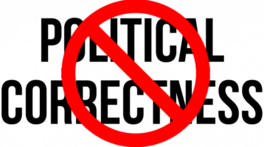
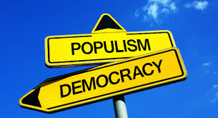
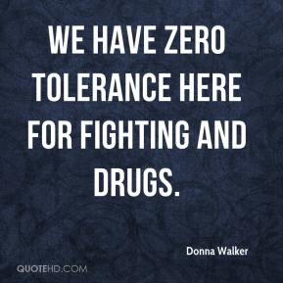
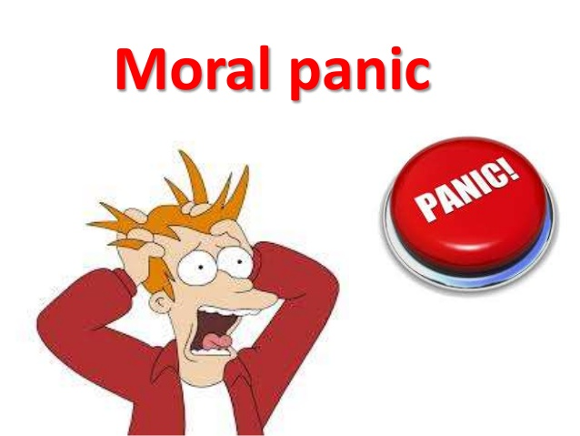
CITIZENSHIP IN THE 21st CENTURY
The development of ICT, changes in the media as well as the social networks (together with major political shifts) have brought to the forefront problems and challenges previously non-existent or at the fringes of politics and research, e.g.

Slide 9
CITIZENSHIP IN THE 21st CENTURY: ‘BACK TO THE FUTURE’
At the centre of these (and other) phenomena is one of the foundational rights associated with the contemporary conception of citizenship as membership in a polity.
What is freedom of expression and why it matters?

Slide 10
FREEDOM OF EXPRESSION: HISTORICAL ORIGINS
“The contemporary debate over free speech”, as Alan Haworth points out, “began life as a set of arguments over religious toleration. After the seventeenth century, the argument was transposed, over time, from a theologically defined to a secular context”.
As a philosophical problem, freedom of expression, as Thomas Scanlon emphasizes eloquently, “is an instance of a more general problem about the nature and status of rights”.

Slide 11
FREEDOM OF EXPRESSION: SOME PRELIMINARY CONSIDERATION
Both historically and conceptually, freedom of expression is among the basic civil liberties associated with the rights-based conception of citizenship and one of the most important principles of a democratic society. As Ronald Dworkin emphasizes in one of his articles, freedom of speech traditionally figures not only as a
special and distinctive emblem of Western culture […] but is a condition of legitimate government as laws and policies are not legitimate unless they have been adopted through a democratic process, and a process is not democratic if government has prevented anyone from expressing his convictions about what those laws and policies should be.

Slide 12
FREEDOM OF EXPRESSION: SOME PARADOXES
An interesting trend is observable in these discussions!!!
On the one hand, there has been little disagreement over the centrality of freedom of expression in the panoply of ideals, concepts and principles associated with citizenship as free and equal membership in a polity.
Protecting and effectively guaranteeing the right to freedom of expression and information is crucial in order to develop the quality of democracy, to stimulate diversity and tolerance, to guarantee the respect for human rights and ultimately to help to realize a better world to live in.

Slide 13
FREEDOM OF EXPRESSION: SOME PARADOXES
On the other hand, despite the convergence of opinion on the importance freedom of expression plays in a democratic society and its centrality among civil liberties, its scope, its justification and its limits are far from uncontroversial or settled.
Discussions over the foundations, nature and value of freedom of expression in a democratic society together with the discussions over its status, scope and justification persist as one of the most complex and controversial philosophical, political and legal challenges.

Slide 14
FREEDOM OF EXPRESSION: BASIC QUESTIONS
Contemporary controversies over freedom of expression revolve around three separate questions, i.e.
what is the value of freedom of expression in a plurally diverse polity;
what justification is offered for freedom of expression;
what are the limits of freedom of expression.

Slide 15
FUNCTIONS ASSOCIATED WITH FREEDOM OF EXPRESSION
The value of freedom of expression in a democratic society can be distinguished along a predominant function associated with a particular form it performs. While some of these functions are primarily social in nature, others are primarily individual. Five separate functions associated with freedom of expression can be identified here, i.e.
the democratic function
the egalitarian function
the epistemic function
the virtue-based function
the self-respect function

Slide 16
THE DEMOCRATIC FUNCTION
The Resolution 1510 (2006) by the Parliamentary Assembly of the Council of Europe on Freedom of Expression and Respect for Religious Beliefs emphasizes that
there cannot be a democratic society without the fundamental right to freedom of expression. The progress of society and the development of every individual depend on the possibility of receiving and imparting information and ideas. This freedom is not only applicable to expressions that are favourably received or regarded as inoffensive but also to those that may shock, offend or disturb the state or any sector of the population, in accordance with Article 10 of the European Convention on Human Rights (ETS No. 5).

Slide 17
THE EGALITARIAN FUNCTION
As the US legal scholar Cass Sunstein emphasizes, freedom of expression “diminishes the gap between a nation’s leaders and its citizens, and for that reason promotes monitoring of the former by the latter”.
On this interpretation, freedom of expression enables every member of a polity to have access to information that enables him to make good choices among conceptions of the good etc.

Slide 18
THE EPISTEMIC FUNCTION
The epistemic function is best represented by the marketplace of ideas rationale for freedom of expression as it is premised on the assertion that the best policy proposal, procedure or outcome arises out of the competition of divergent ideas in a free and transparent public discourse.
By comparing different conceptions of the good or having at our disposal different experiences and perspectives there is a twofold advantage. By being acquainted with different experiences and perspectives individuals have more options available to choose from. At the same time, by having more options available, individuals are in a better position to evaluate one’s own particular perspective or experience.
In this sense, freedom of expression contributes significantly to the support of the values associated with the classical Millian argument for the development of autonomy and individuality, that social diversity and choice are increased or strengthened.

Slide 19
THE VIRTUE-BASED FUNCTION
As the ECHR poignantly emphasized in one of its judgements “freedom of expression (…) constitutes one of the essential foundations of a democratic society and one of the basic conditions for its progress and for each individual’s self-fulfilment.
(…) it is applicable not only to “information” or “ideas” that are favourably received or regarded as inoffensive or as a matter of indifference, but also to those that offend, shock or disturb. Such are the demands of that pluralism, tolerance and broadmindedness without which there is no “democratic society”.
In this respect, freedom of expression is of crucial importance for the cultivation of basic civic virtues including toleration, mutual respect etc.

Slide 20
THE SELF-RESPECT FUNCTION
Freedom of expression performs also the function associated with the development of self-respect. By enabling each and every member of a polity to freely express himself, it contributes significantly, as Jeremy Waldron emphasizes, to one’s self-respect and dignity “in the sense of these persons’ basic social standing, of the basis of their recognition as social equals, and of their status as bearers of human rights and constitutional entitlements”.

Slide 21
FREEDOM OF EXPRESSION: OVERALL EVALUATION
As these examples clearly illustrate, the most common way to defend freedom of expression is premised on the contact hypothesis, namely the assertion that freedom of expression and the associated exposure to diversity fosters interracial, inter-religious, interethnic, intercultural respect and solidarity and is therefore conducive to the overall civic as well as individual benefits.
As has been presented in this section, major arguments associated with freedom of expression include arguments about truth discovery, social stability, personal development, democracy, check on possible abouse of authority etc. Nevertheless, the basic justification for freedom of expression, as Kent Greenawalt emphasizes is that “speech promotes the discovery of truth”.

Slide 22
LIMITS ON FREEDOM OF EXPRESSION
The crucial difficulty of the application and limitations of freedom of expression lies in the balancing of competing rights and interests together with the civic interests. Like most of the rights and freedoms that are part of the ECHR, freedom of expression is not absolute. Its exercise must take into account other rights and interests that are part of the Convention.
These limitations of the exercise of freedom of expression
is the consequence of the way that a democratic society operates, where a constant interaction and conflict of individual and societal values occur, and where choices must be made – after careful weighting – of the values which must prevail over other values in the specific circumstances of each case.

Slide 23
OBJECTIONS TO FREEDOM OF EXPRESSION
Despite the importance freedom of expression plays in a democratic society, several objections have been advanced by a vast range of critics against its overall. In fact, as T.M. Murray emphasizes, there is a set of separate objections to freedom of expression, i.e.
the idea that extreme speech incites either violent acts or hatred;
that tolerance is a weak-willed alternative to moral conviction;
that tolerance is a doctrine like any other;
that toleration threatens the traditional values that bind society together; and
that too much tolerance will destroy tolerant societies.

Slide 24
FREEDOM OF EXPRESSION: IMPLICATIONS FOR EDUCATION
Contemporary discussions over the status, scope and justification of freedom of expression in education therefore need to take into account three separate issues, i.e.
what is the place of freedom of expression in a plurally diverse polity;
what are the basic aims of education in general; and
what is the relationship between different goals that are part of the educational agenda that takes freedom of expression as one of its basic aims?

Slide 25
MAJOR CHANGES IN THE STATUS AND ROLE OF CITIZENSHIP EDUCATION
The ‘contemporary’ and the ‘non-standard’ challenges to citizenship education requires two basic changes, i.e.
change of the basic conception of education; and
change of educational/pedagogical practice.
Important initiatives (promoting alternative solutions) have been developed my major stakeholders in order to tackle the problems and challenges presented above.

Slide 26
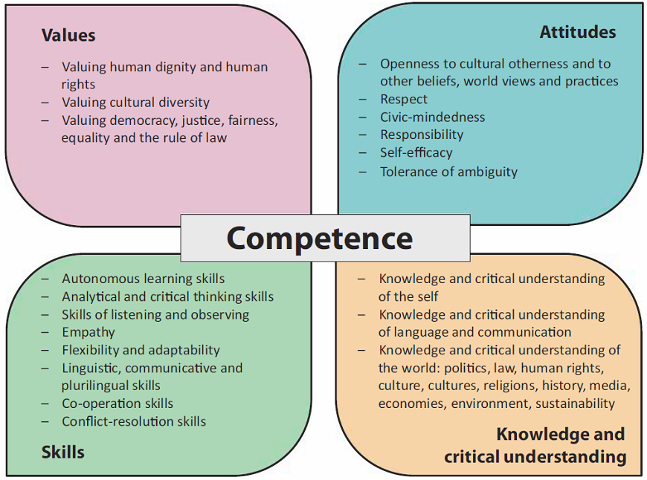
CIVIC COMPETENCE

Slide 27
DIMENSIONS OF CIVIC COMPETENCE
Individuals with a developed civic competence should have four main characteristics, i.e.
cognitive dimension (legal and political skills; knowledge of the principles, concepts and values of democratic citizenship and of civil rights and freedoms);
ethical dimension (ethical skills and sensitivity that are a prerequisite for an independent social action including communicative skills);
social dimension (cooperation, conflict resolution in accordance with fundamental democratic principles, solidarity and responsibility for community action); and
communicative dimension (democratic communicative culture, consensus seeking, expressing and justifying one’s values, viewpoints and arguments).

Slide 28
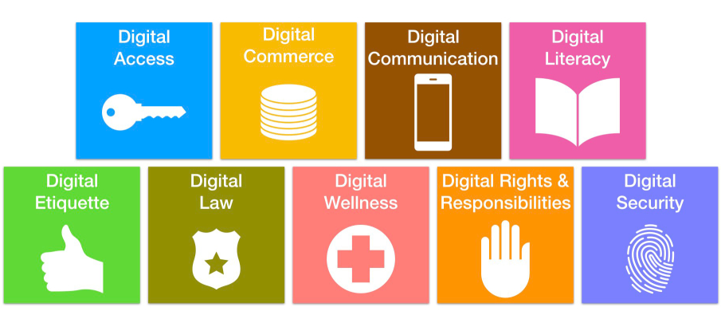
‘PARADOXES’ of DIGITAL CITIZENSHIP
Algorithms as a foundational component of digital citizenship has also a number of negative ‘side effects’, e.g.:
amplification of one’s beliefs & values (‘echo chamber phenomenon’);
diminishing of the exposure to diversity
society’s polarization;
social distance & conflicting diversity.

Slide 29
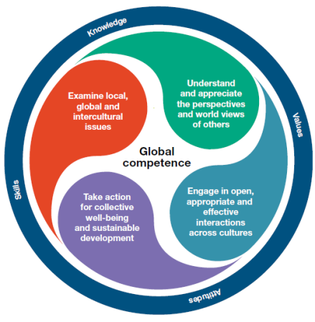
OECD’s SURVEY PISA: the ‘GLOBAL COMPETENCE’ initiative

Slide 30
CITIZENSHIP IN THE 21st CENTURY
Possible solutions to the problems and challenges ‘traditional’ models of citizenship education do not encompass are advanced by digital citizenship and global competence framework.
The crucial role in tackling these challenges is bestowed upon
citizenship education
Public expectations from education: EXTREMELY HIGH!!!

