Slide 1
Fear of the Technological
Presented by Martin Berov

Slide 2
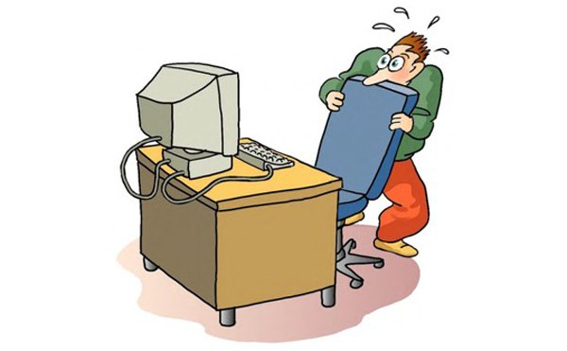
Technophobia
The fear of technology, also known as technophobia, is the fear or dislike of advanced technology or complex devices, especially computers. Technophobia is surprisingly common. In fact, some experts believe that we all suffer at least a small amount of nervousness when confronted with new technology. In today's rapidly changing world, it can be easy to feel out of touch.

Slide 3
Nomophobia
Nomophobia is a word for the fear of, or anxiety caused by, not having a working mobile phone. It has been considered a symptom or syndrome of problematic digital media use in mental health. Nomophobia is usually considered a behavioral addiction; it shares many characteristics with drug addiction. The connection of mobile phones to the Internet is one of the causes of nomophobia.

Slide 4
FOMO
FOMO or fear of missing out is the feeling of apprehension that one is either not in the know or missing out on information, events, experiences, or life decisions that could make one's life better. While it isn’t exclusive to tech the problem has been steadily growing bigger because of the internet. Social networking sites creates many opportunities for FOMO. While it provides opportunities for social engagement, it offers a view into an endless stream of activities in which a person is not involved.

Slide 5
Fear of Comparison
We tend to compare ourselves or our life with others with a general belief that other people’s lives are better than us and are happier than us. When we see photos of celebrities or any famous people, our thoughts automatically spiral into comparison in terms of happiness, physical and mental aspects and material things. And thus we start to feel anxious about things we don’t have and how happy or satisfied we are when compared to others.

Slide 6
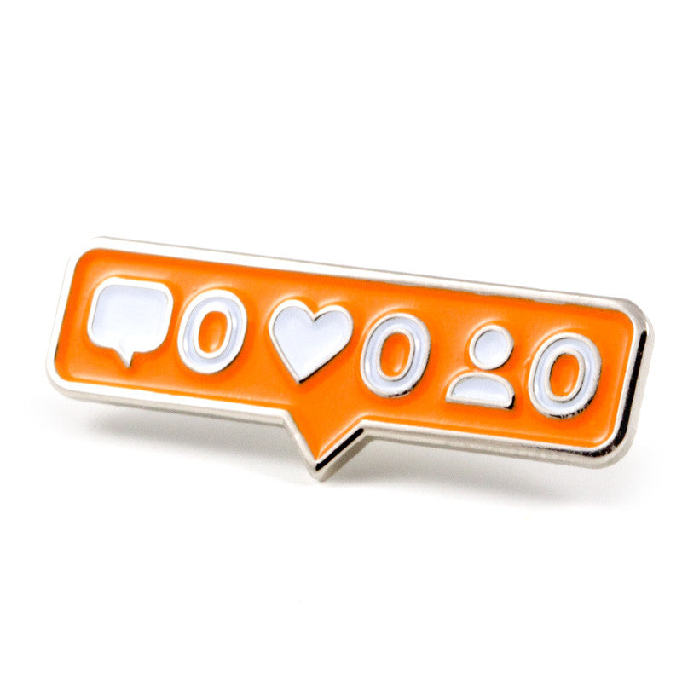
Fear of Judgment/Rejection
No matter how independent we are, we still care what other people think. When we post a photo/video of us on social media, we do that with an expectation of receiving acknowledgements in terms of likes, comments and shares. But when we don’t get the expected number, we tend to get disappointed and start feeling anxious about why we didn't receive any. This can lead to self-doubt, stress or even depression.

Slide 7
Fear of personal information tracking
Internet privacy is a complicated issue full of conflicting interests and misinformation. People on the internet often fear that their private information will end up in the hands of someone it doesn’t belong to and that it would be used for nefarious purposes.

Slide 8
Fear of information flow
People often use the internet to get their news but what if those news were fake, that is the fear of information flow. We as humans often believe a lot of the thing we see on the internet, and hoax news or fake tips can lead to anxiety, depression and even in some cases harm.

Slide 9
Overcoming our fears.
Overcoming your fears is often a daunting task but you should persevere because the end result will often be worth it. There are many ways of overcoming the previously mentioned fears and some of the most popular are:
Taking time of the internet or technology in general, doing research to prevent the absorption of misinformation, accept that you aren’t perfect and some people will dislike you. There is also the option of talking about it.

Slide 10
Thank you for your attention

