Slide 1
Bulgaria 2022
Secondary School Domžale

Slide 2
Secondary School Domžale
Website
Facts
600 pupils, aged 15—20
Only upper secondary school in the municipality
General education program
Vocational programs (computer technician, mechanical engeneering technician, mechanic, plumber, merchant, seller)
Historical: leather processing professions
Since 1948

Slide 3
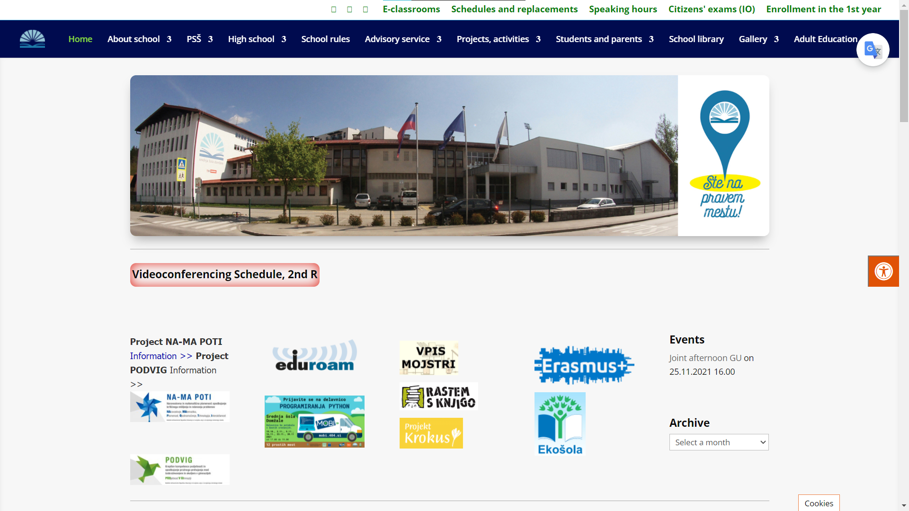

Slide 4
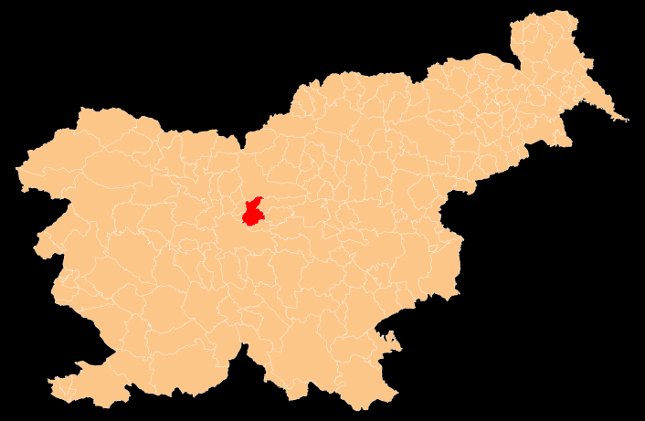
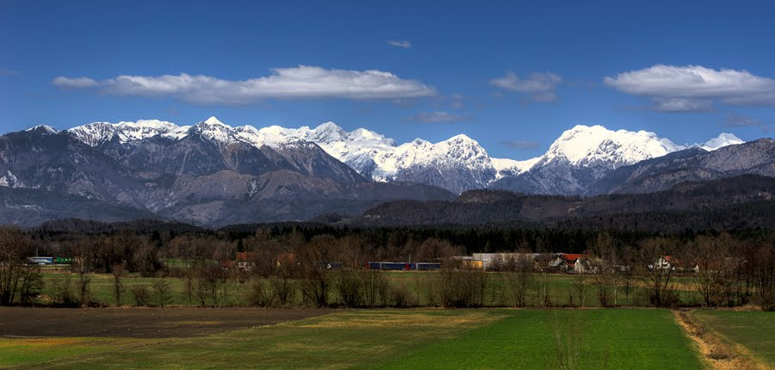
Municipality of Domžale
Central Slovenia
Area: 72 km²
Elevation: 304 m a.s.l.
Population: 32,000 (city 13,200)
Railway line since 1891
4 villages with
straw-hat industry
Market town since 1925
City since 1952

Slide 5
Municipality

Slide 6
Country
Facts on Slovenia. What does it mean?
Area : 20.000 ${km}^{2}$
Population: 2.000.000
Alps, Mediterranean, Pannonian
Neighbours: Austria, Hungary, Croatia, Italy
Capital : Ljubljana
In a shape of a chicken

Slide 7
Country

Slide 8
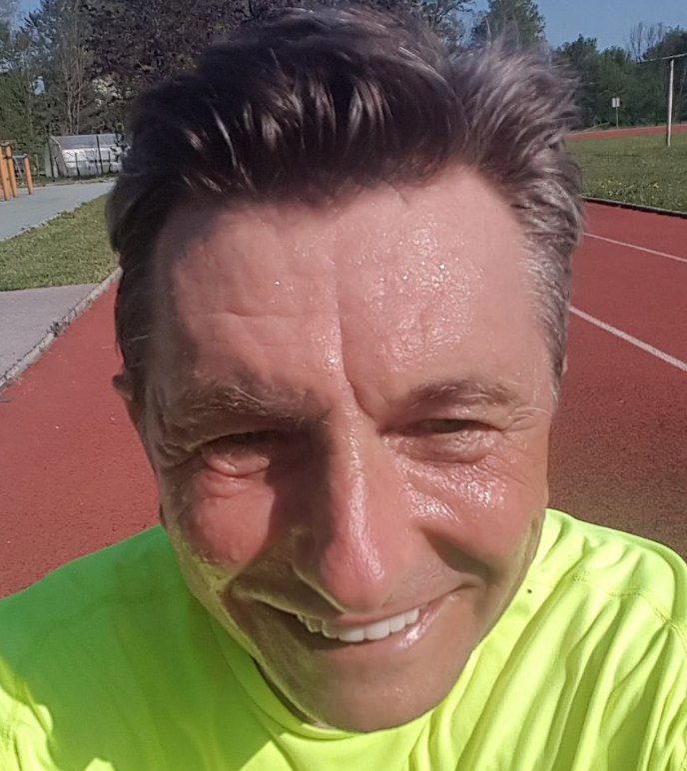
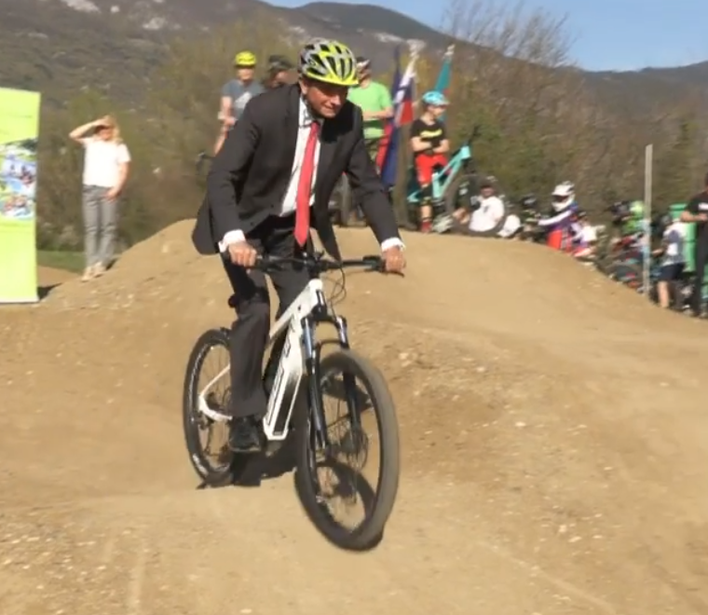
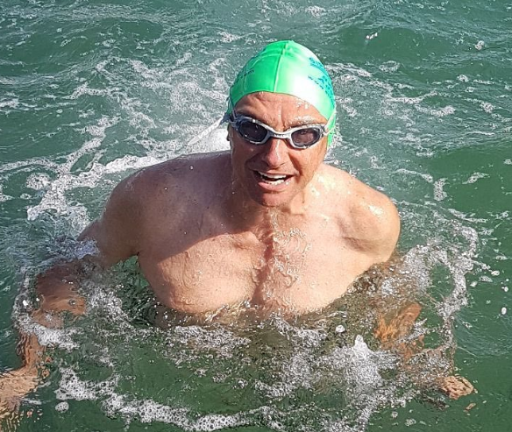
President – Borut Pahor
Known as the Instagram president
The only president who spoiled a James Bond movie

Slide 9
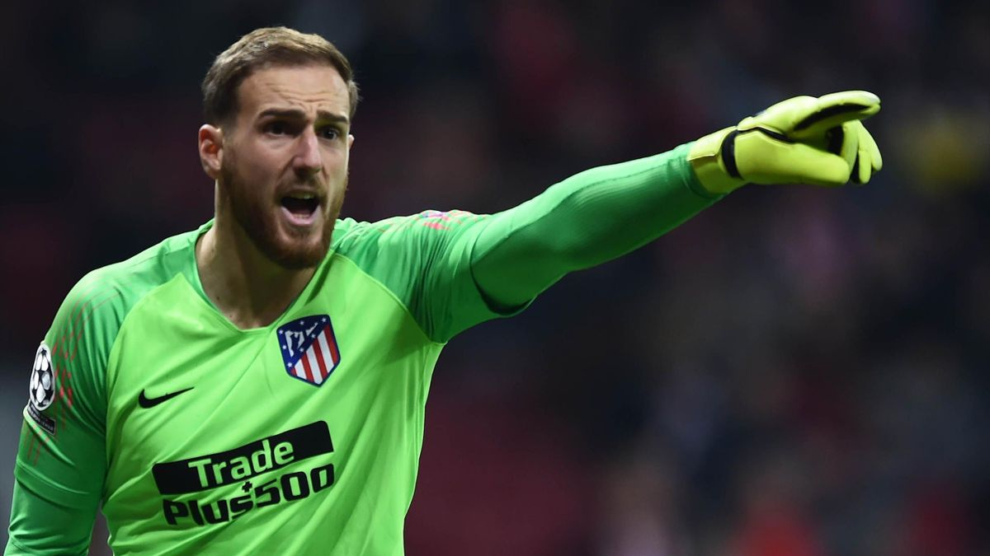
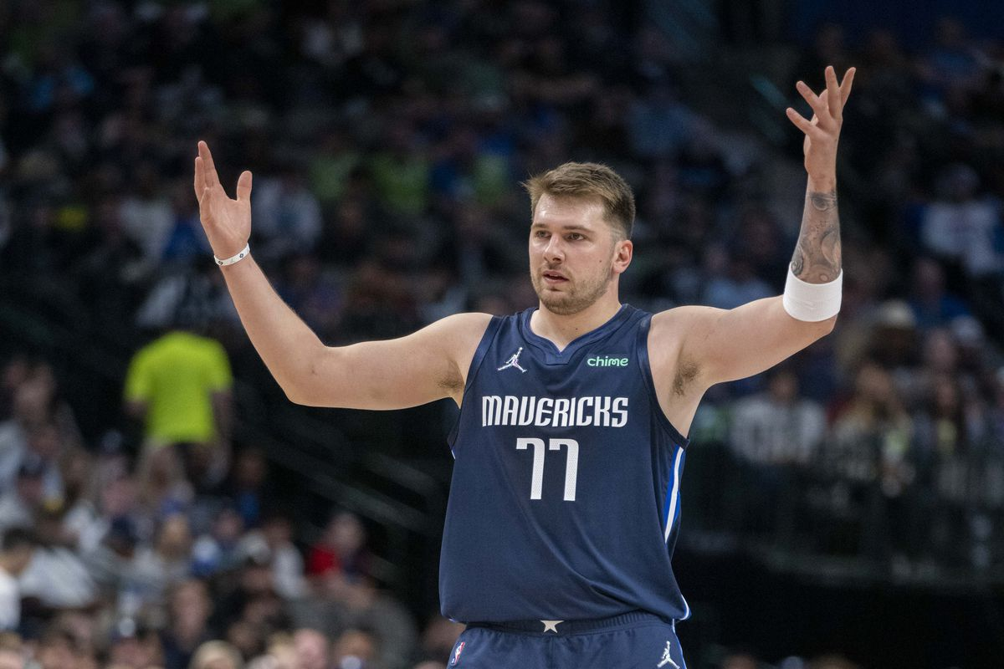
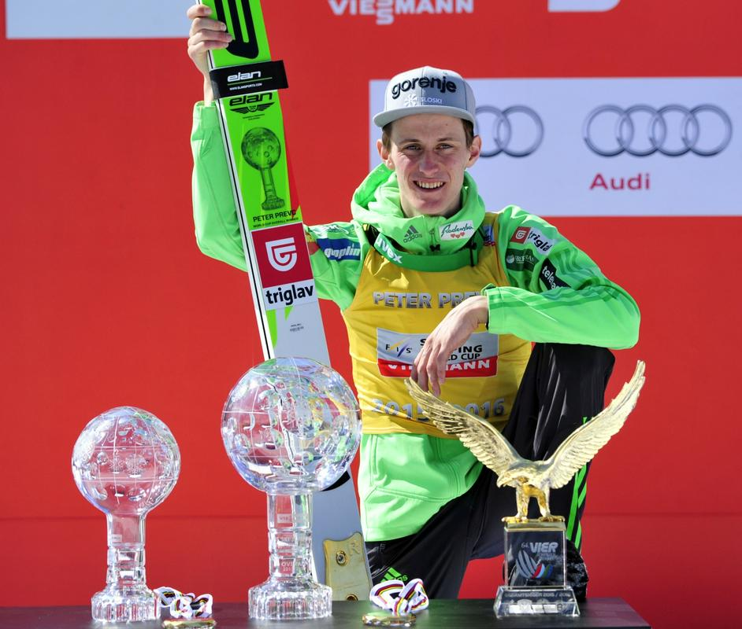
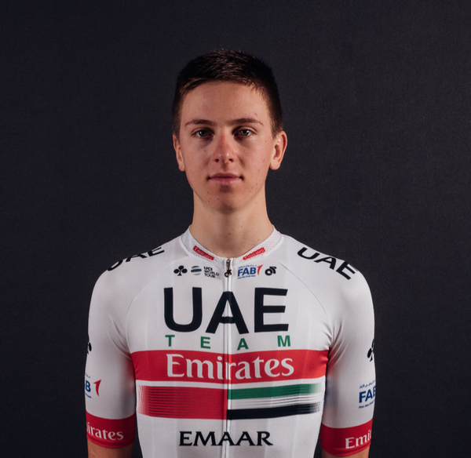
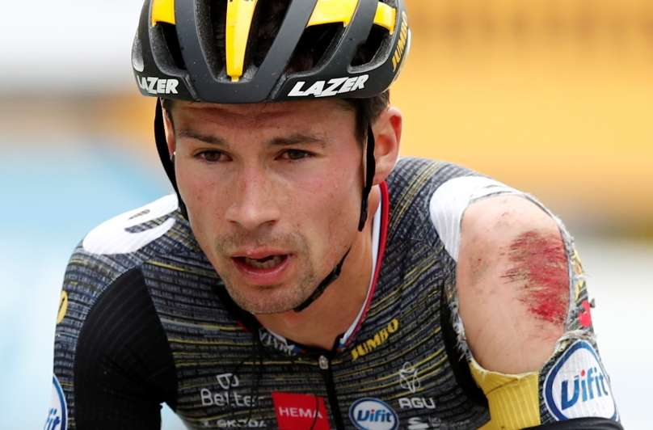
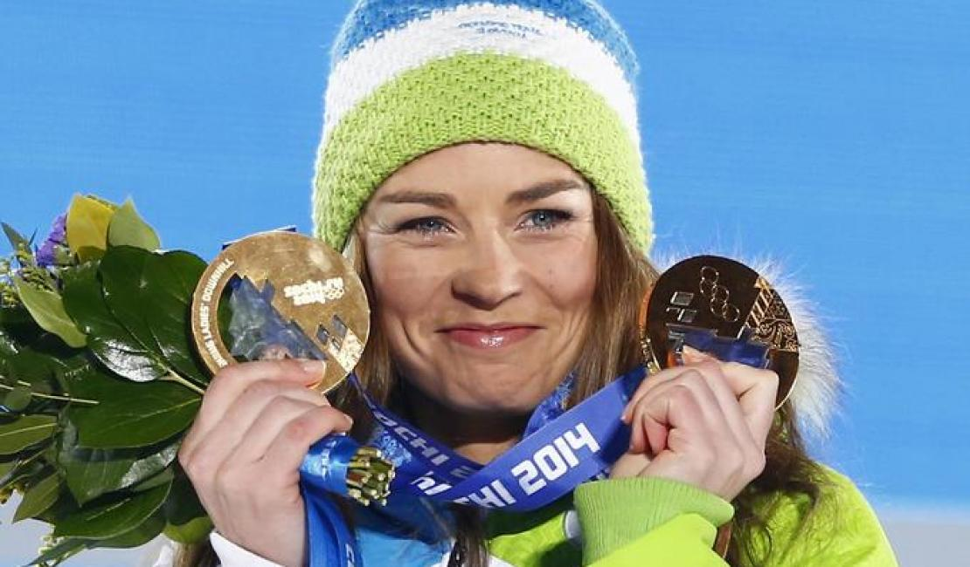
Sports
Jan Oblak - Football
Luka Doncic - Basketball
Tadej Pogačar - Cycling
Primož Roglič - Cycling
Peter Prevec – Ski jumping
Tina Maze – Skiing (retired)

