Slide 1
Fake news and media literacy
The Nösnäsgymnasiet way ...

Slide 2
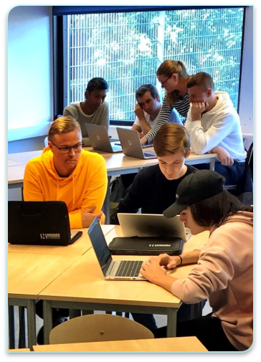
The school library
A part of the educational activities.
Search of information.
Search reasoning.
Civic (online) reasoning.
News/media evaluation.
Scientific writing.
Cooperation with the teachers.
Notes:
Function. Media literacy.

Slide 3
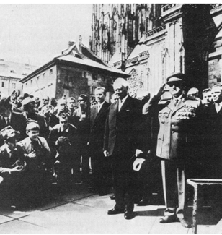
History Classes
Criticism of sources Classical tools: Proximity
Dependence
Tendency
Who's toe is this?

Slide 6
Technique college, digitalisation project

Slide 7
The importance of sourcecriticism in a digitized society

Slide 8
Philosophy Classes
1. Two important concepts: truth and knowledge
2. Argument analysis

Slide 9
Truth and knowledge
What does it mean when we say "I know this"?
Discussions about knowledge as justified, true belief (JTB) and the Gettier-problem
Different perspectives on the concept of truth: the correspondence theory, the coherence theory...

Slide 10
Argument analysis
The concepts truth and relevance
Exercises in evalutating arguments
The importancy of evaluating the arguments as they are, not as they appear to be

Slide 11
Questions?

