Slide 1
Media Education in Bulgaria Razlog Vocational High School
2019-1-SI01-KA229-060523
Fake News among Teenagers –
Towards a more responsible media literacy

Slide 2
Report March 2018, published by Open Society Institute – Sofia
The Northwestern European societies have higher resilience potential to fake news with better education, free media and high trust between people.
The Balkan countries are most vulnerable to the adverse effects of fake news and post-truth, with controlled media, deficiencies in education and lower trust in society.

Slide 3
Report March 2018, published by Open Society Institute – Sofia
Media freedom is imperative, but sometimes overlooked factor, to tackling post-truth and fake news, considering also that people still tend to trust traditional media more as opposed to social networks.
Education remains the key component in dealing with the post-truth phenomenon – as the general education level as well as tailored media literacy training.

Slide 4
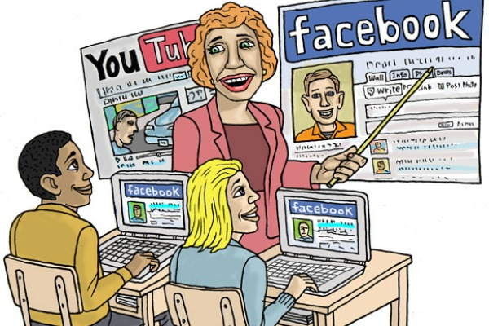
Media Literacy Index 2018
Denmark 71
Netherlands 70
Sweden 69
Belgium 64
Germany 62
United Kingdom 60
Slovenia 60
Austria 60
Portugal 59
France 56
Greece 39
Romania 38
Bulgaria 30
Turkey 16
Macedonia 10

Slide 5
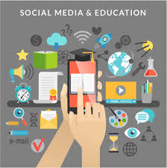
Education
Media literacy does not feature as a subject in schools in our country, and only some aspects of media and information literacy are scattered across several subjects (such as Mother Tongue and Civic Education). At the same time, subjects focusing on the technical skills of using ICT have been incorporated in the education system, but schools are underequipped and teachers undertrained for their application, which prevents schools from playing a significant role in developing digital literacy with students. + another PPT

Slide 6
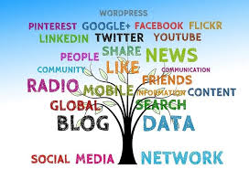
Lifelong Programme Project ‘’Media Education in Secondary Schools: Challenges and Possibilities ‘’
News in English lessons
Gender Stereotypes
Films and TV
Political Cartoons
Chat rooms

